Slide 1
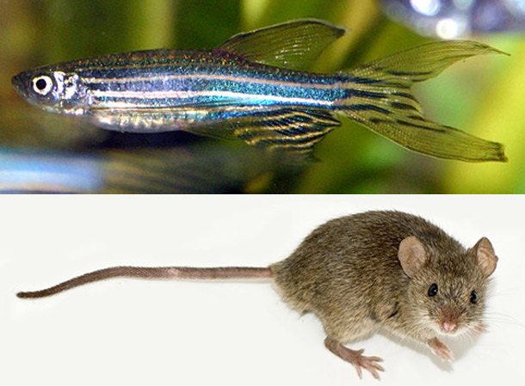
Preclinical Animal Models for the Study of SLOS
Christopher A. Wassif M.S. PhD

Slide 2
Zebrafish Objective
Generate a viable animal model for SLOS to allow:
Studying developmental and functional neurological defects secondary to dhcr7 deficiency.
Efficient in vivo drug screening.

Slide 3
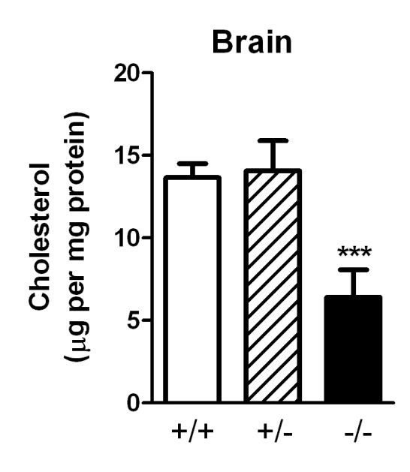
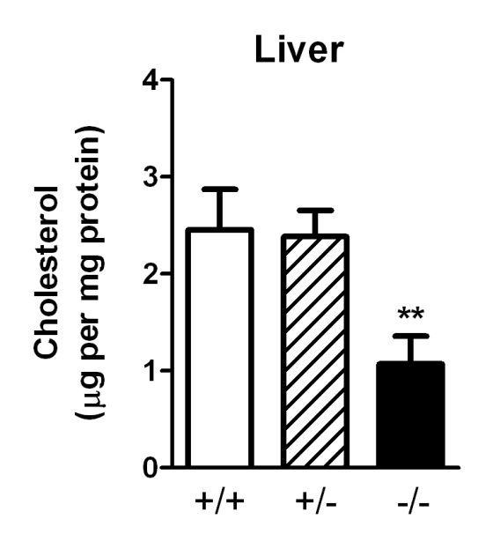
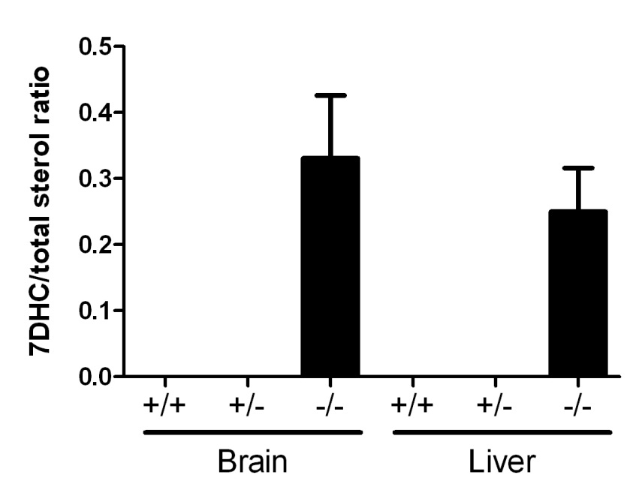
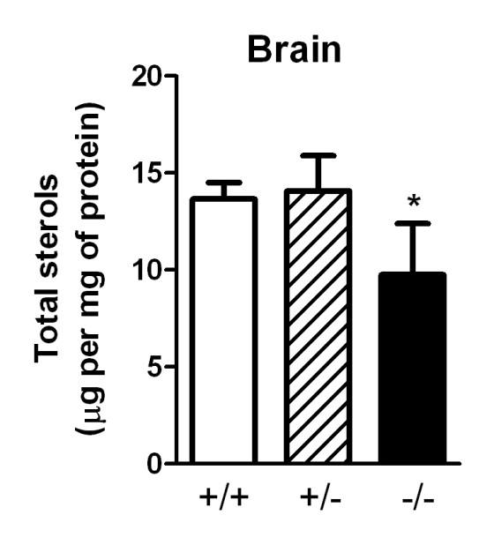
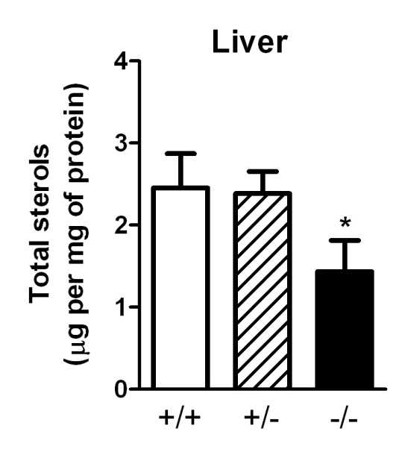
GC/MS analysis: Dhcr7 ex 4 F2 fish
5 weeks old fish
N=5 for brain, N=4 for liver
c.383_385delins48 (p.Tyr128_Phe478delinsLeu)

Slide 4
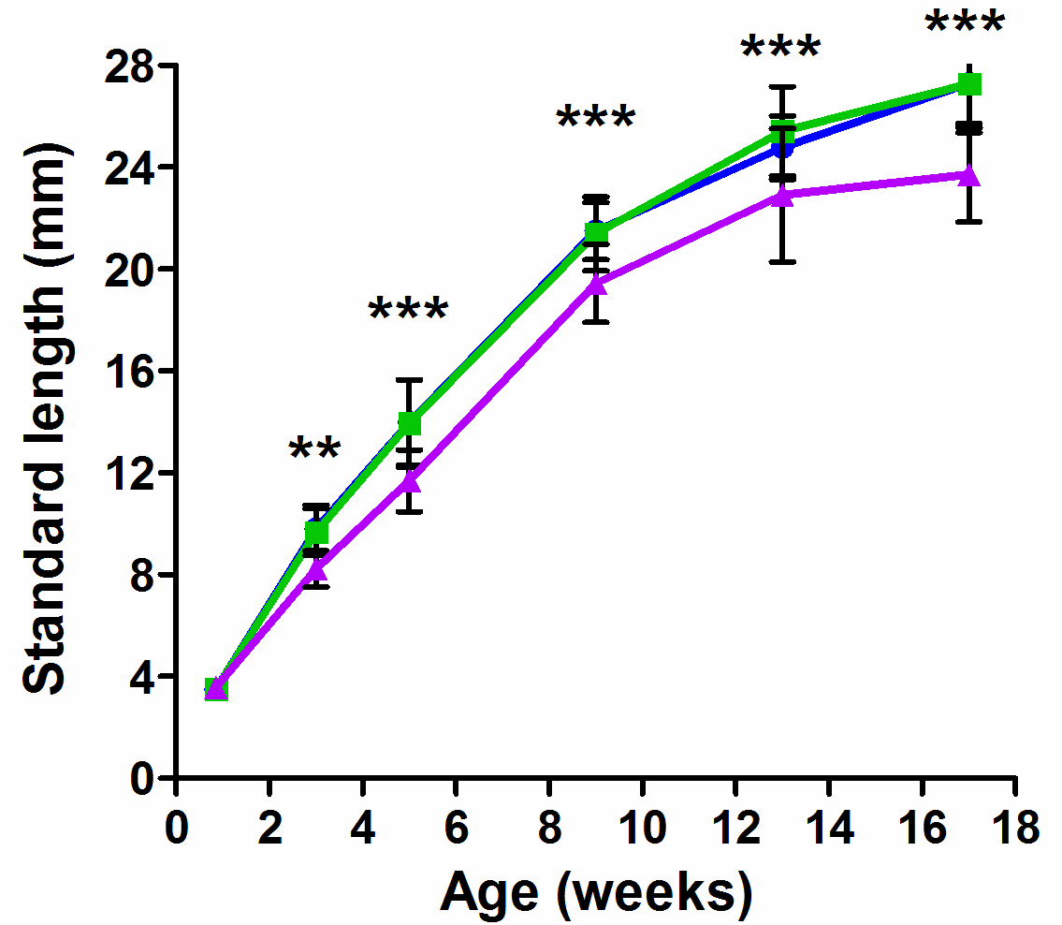
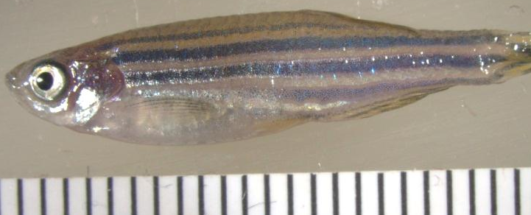
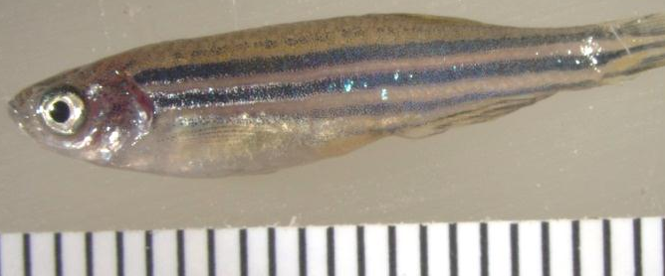
Growth curves of dhcr7-deficient fish
N = 15-50 (progeny of two independent crosses)
+/+
(21.8mm)
+/Δ13
(21.5mm)
♀
Δ13/Δ13
(19.5mm)
 | + | Δ13
+
Δ13
♂
Mutant fish smaller than controls from 3 weeks of age

Slide 5
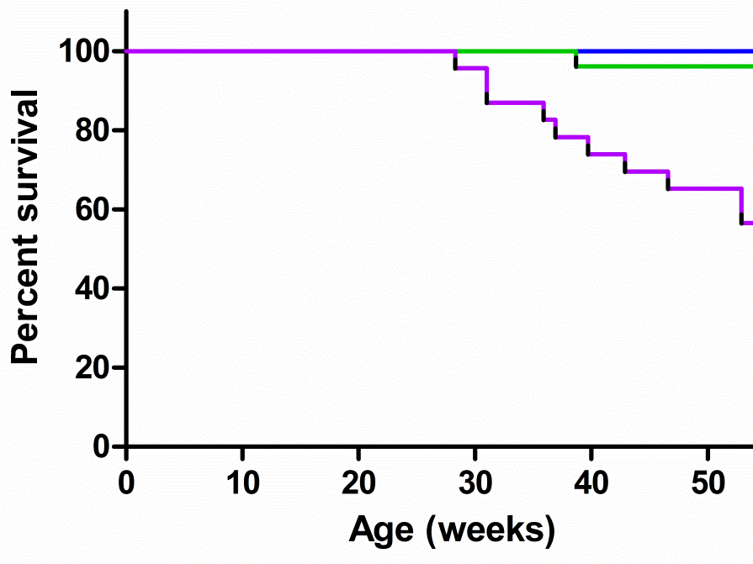
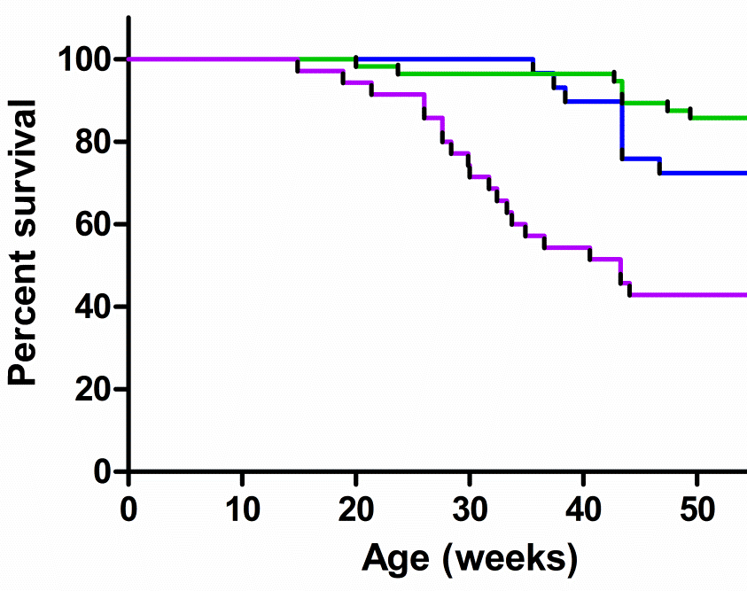
Survival of dhcr7-deficient fish
dhcr7 Δ13 allele
dhcr7 Δ14 allele
♀
♀
 | + | Δ13
+ | N=22
Δ13 | N=26 | N=23
 | + | Δ14
+ | N=29
Δ14 | N=56 | N=39
♂
♂
Mutant fish are dying prematurely
Large variability in survival (1-year-old fish still alive)

Slide 6
Conclusion and Future Plan
We have successfully generated a zebrafish model of SLOS.
    This model recapitulates the biochemical defect.
    Has significant growth retardation
    Dies prematurely
We will complete the initial characterization of these fish and hope to use this model to test future therapeutic interventions.

Slide 7
Mouse Studies Focused on Modifiers
Genes and Oxysterols

Slide 8
Genetic Modifiers or Modifier Genes
What is a modifier gene?
  A genetic modifier, when expressed, is able to alter the expression of another gene.
  Modifier genes can affect transcription and alter the immediate gene transcript expression, or they can affect phenotypes at other levels of organization by altering phenotypes at the cellular or organismal level

Slide 9
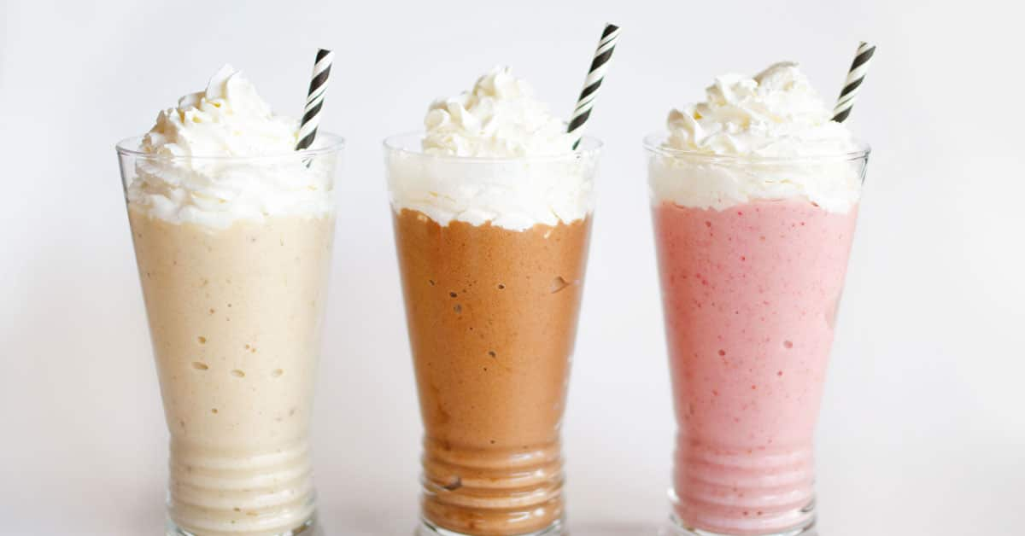
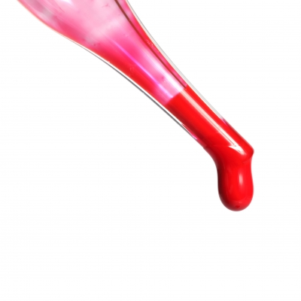
Example of a Modifier
Vanilla
Milkshake
Vanilla
Milkshake
Modifier
Red Food Coloring

Slide 10
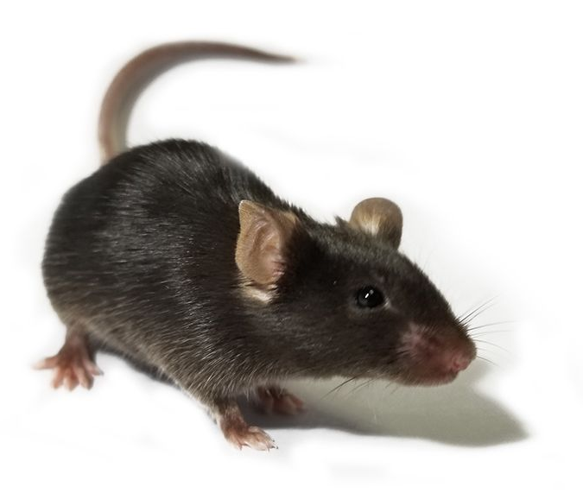
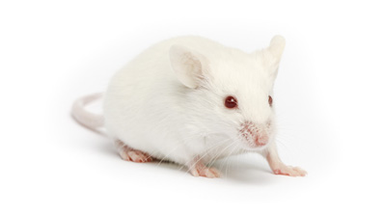
Modifiers in SLOS
T93M/Null
C57 Black6 J
FVB/NJ
93% of T93M/Null
die at birth
100% of T93M/Null
Survive

Slide 11
Strategy
T93M/T93M (BL6) X WT/Δ3-5 (FVB)
F1 generation
T93M/WT (BL6/FVB) T93M/Δ3-5 (BL6/FVB)
* 1st Checkpoint
50:50
50:50
T93M/Δ3-5 (BL6/FVB) X T93M/T93M (BL6)
50:50
100
F2 generation
T93M/T93M
(BL6/FVB)
* 2nd Checkpoint
T93M/Δ3-5
75:25
T93M/Δ3-5
(BL6/FVB)
(BL6)
X T93M/T93M
75:25
100
T93M/T93M
(BL6/FVB)
* 3rd Checkpoint
F3 generation
(BL6/FVB)
T93M/Δ3-5
87.5:12.5

Slide 12
Survivability of T93M/Δ3-5 Across Generations
F₀
F₁
F₂
BL6 Female
BL6 Male
BL6 Female
FVB Male
BL6 Female
F1 Male
X
X
X
(WT/Δ3-5)
(T93M/T93M)
(WT/Δ3-5)
(T93M/T93M)
(T93M/T93M)
(T93M/Δ3-5)
T93M/Δ3-5
T93M/Δ3-5
T93M/Δ3-5
% Genotype
% Genotype
% Genotype
(n = 22)
(n = 42)
(n = 42)
% Strain:
100 : 0
50 : 50
75 : 25
BL6 : FVB
BL6 : FVB
BL6 : FVB

Slide 13
Conclusion and Future Plan
This inheritance pattern suggests a single autosomal recessive modifier gene in the C57BL/6 strain.
We are collecting surviving as well as pups that have died to map the modifier responsible for the survival phenotype.
This may provide insight to other therapeutic approaches to SLOS.

Slide 14
7DHC Oxysterols
Oxysterols in dhcr7-deficient zebrafish larvae (Libin Xu)
CYP7A1
CYP3A4
CYP3A4
CYP46A1
Enzymatic:
Free radical:

Slide 15
27-hydroxy-7-dehydrocholesterol
DHCR7
HO
HO
7-Dehydrocholesterol Cholesterol
CYP27
CYP27
OH
OH
DHCR7 ?
HO
HO
27-hydroxy-7-dehydrocholesterol 27-hydroxycholesterol

Slide 16

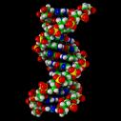
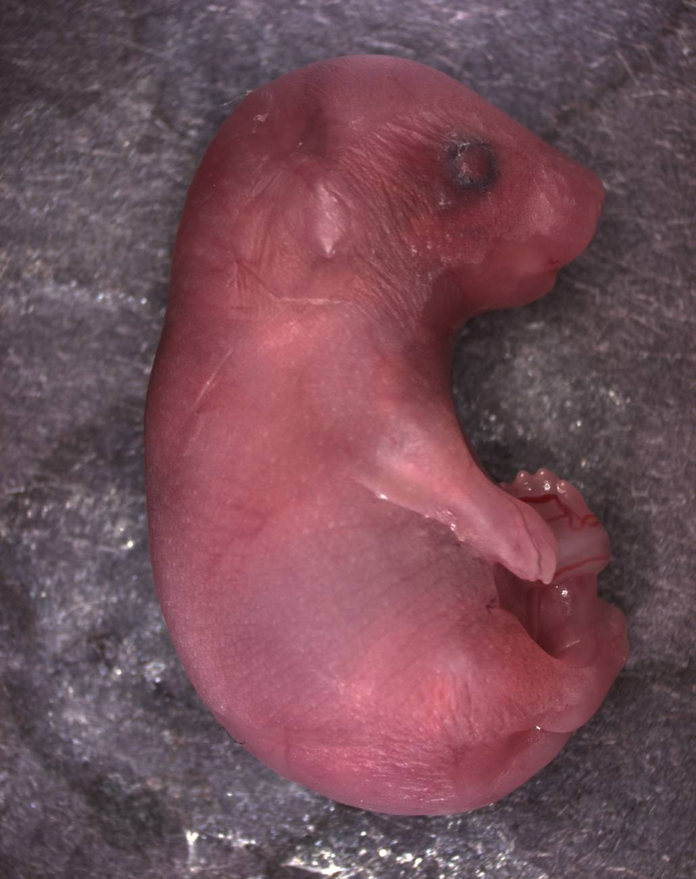
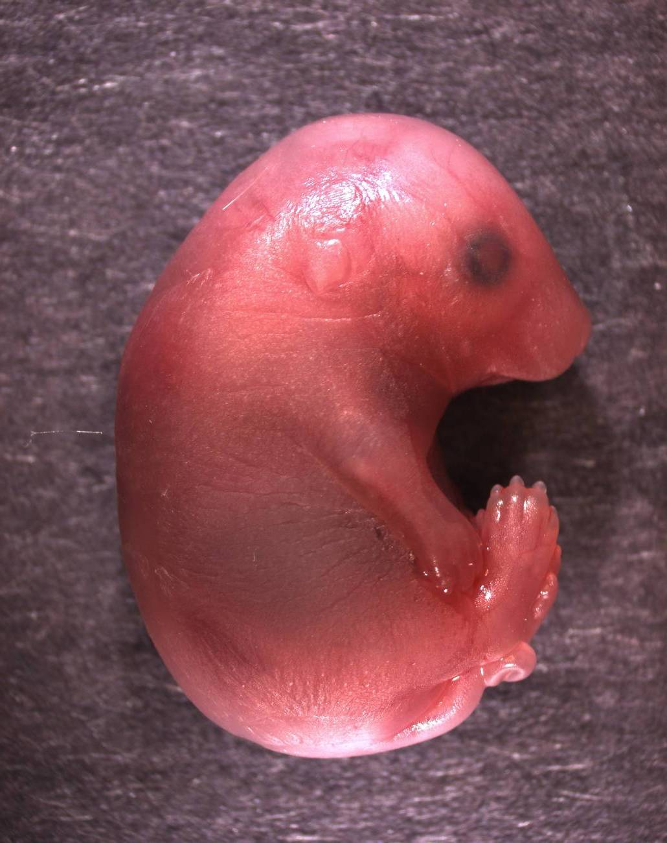
Dhcr7Δ3-5/Δ3-5:CYP27Tg+
Dhcr7^{Δ3-5/Δ3-5}
Dhcr7^{Δ3-5/Δ3-5}:CYP27Tg+

Slide 17
27-hydroxy-7-dehydrocholesterol
100
100
Cholesterol (mg/dl)
Cholesterol (mg/dl)
50
50
0
0
0.00
0.25
0.50
0.75
0.00
0.25
0.50
0.75
27-hydroxycholesterol
(μM)
27-hydroxy-dehydrocholesterol
(μM)
27-hydroxy 7-dehydrocholesterol
27-hydroxy 8-dehydrocholesterol
27-hydroxy 7+8-dehydrocholesterol

Slide 18
Oxysterols and SLOS
200
Total Sterols (mg/dl)
100
0
0
10
20
30
40
50
Dehydrocholesterol (mg/dl)

Slide 19
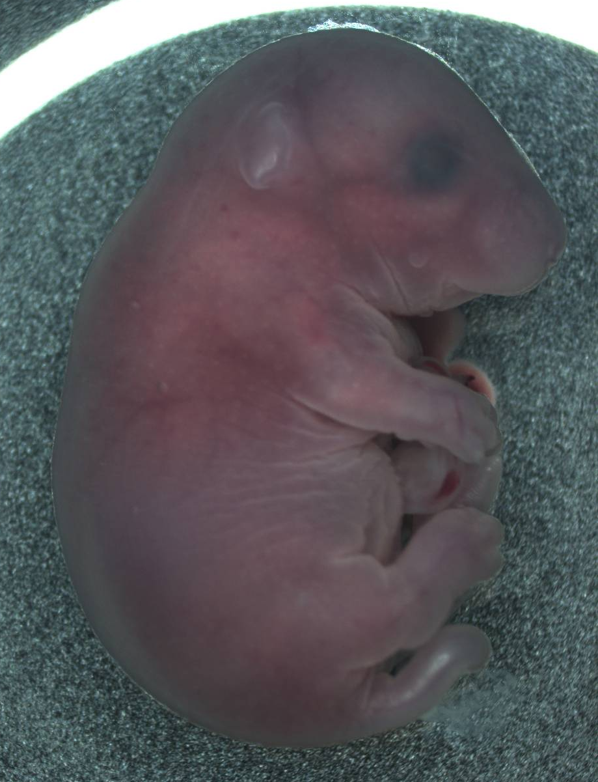
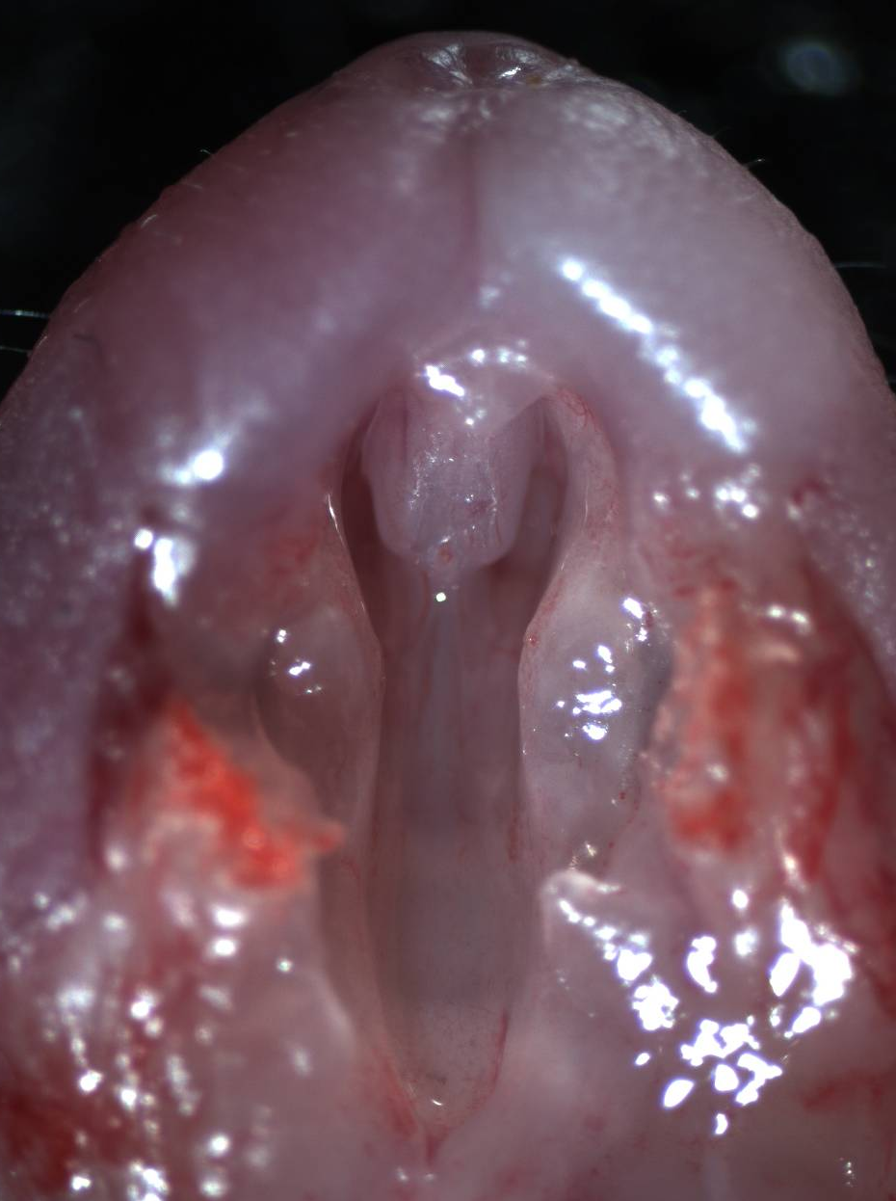
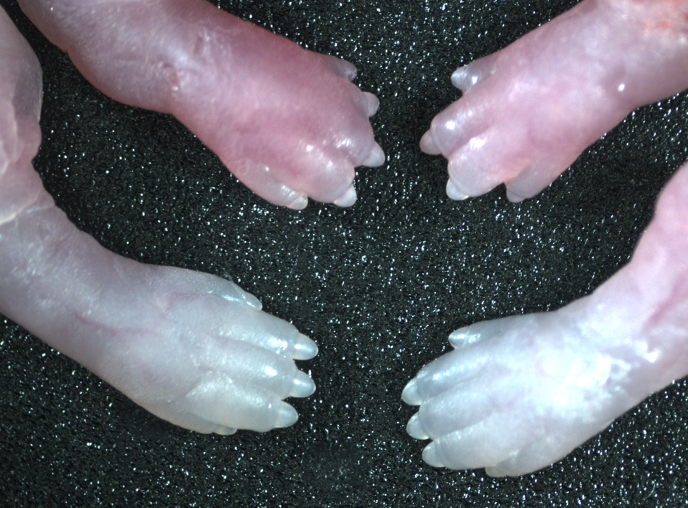
Dhcr7Δ3-5/Δ3-5:CYP27Tg+
Genotype
Dhcr7-/- Dhcr7-/-
CYP27Tg- CYP27TG+
Malformation
Cleft Palate 0-9% 77%
Micrognathia 0 100
Umbilical Hernia 0 100
Limb Defects 0 50
Curled Tail 0 100
Mutant-Tg
Control

Slide 20
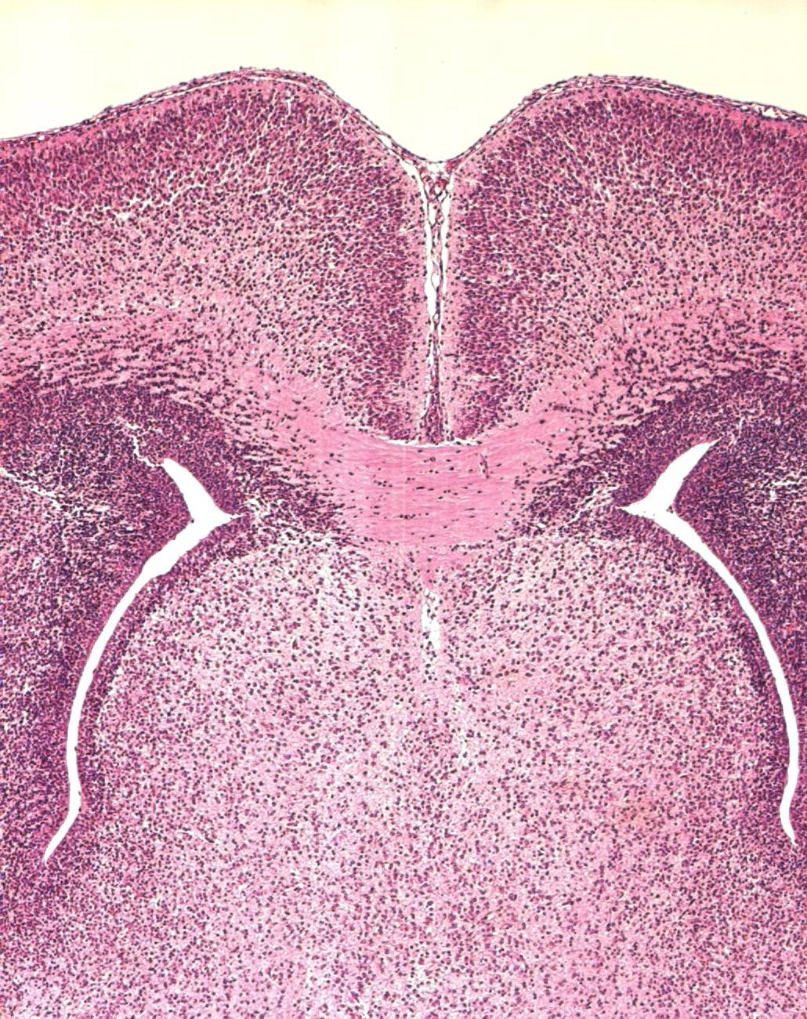
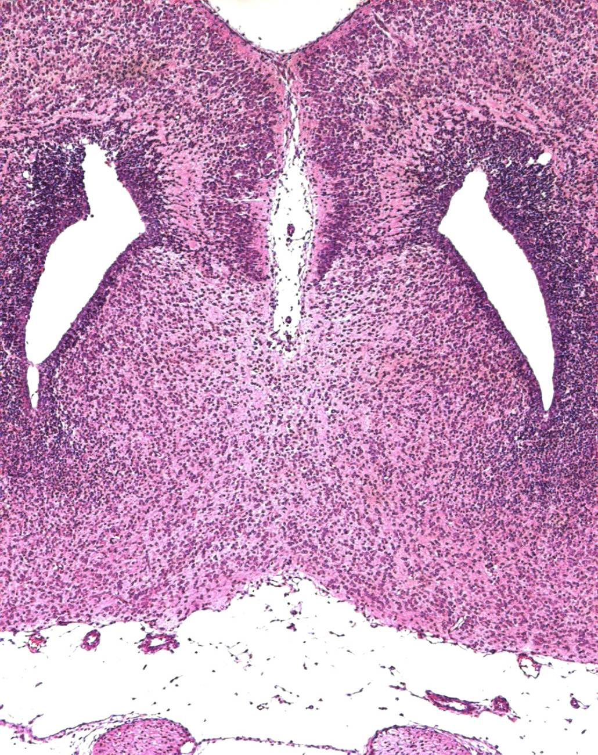
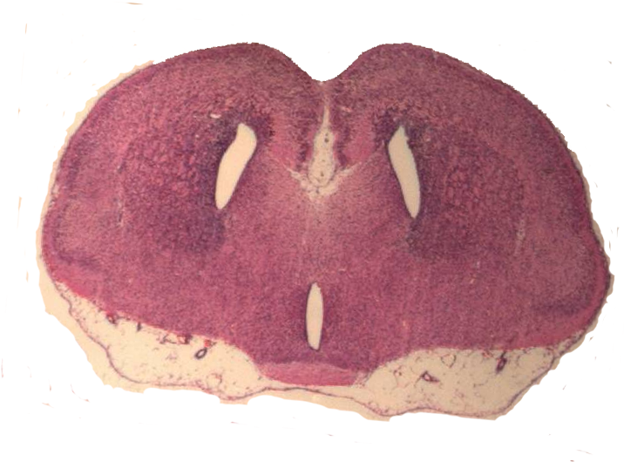
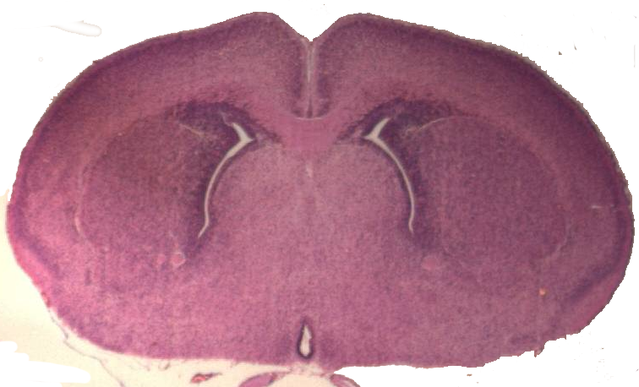
Dhcr7Δ3-5/Δ3-5:CYP27Tg+
  CNS Malformations
Ventricular enlargement
Agenesis of the anterior commissure
Reduction of the cortical plate
Other Malformations
Lingual and Dental Hypoplasia
Cardiac Malformations (VSD)
Control Dhcr7^{Δ3-5/Δ3-5}:CYP27Tg+

